Slide 1
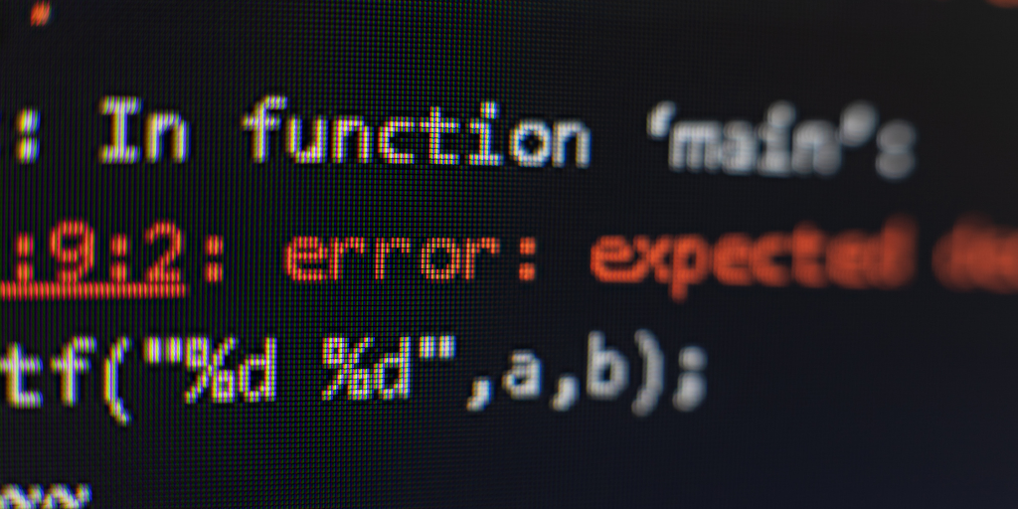
Fixing Errors
Why isn’t my code working? What do these errors mean? Why doesn’t my circuit work?

Slide 2
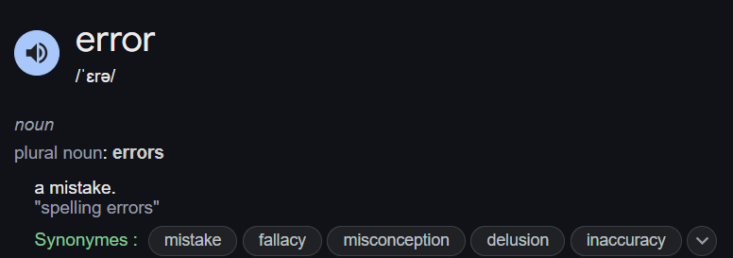
What is an error?

Slide 3
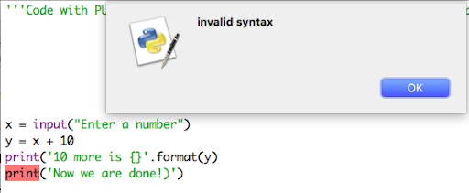
What are the different kinds of errors?
What kind of error is below? Can you spot it?

Slide 4
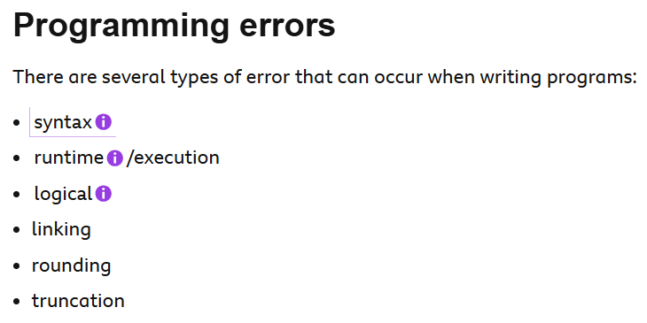
Notes:
https://www.bbc.co.uk/bitesize/guides/zmthsrd/revision/4

Slide 5
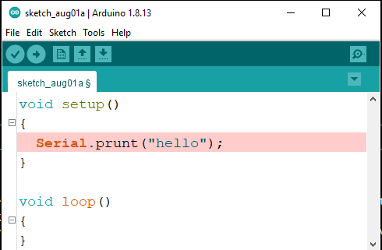
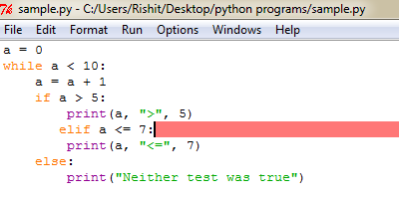
Syntax Errors
These are errors that occur within the code (eg. incorrect formatting)

Slide 6
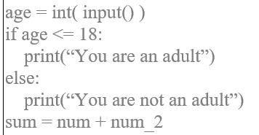
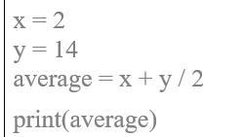
Logic Errors
These are errors caused by human error (i.e. code does not logically make sense)

Slide 7
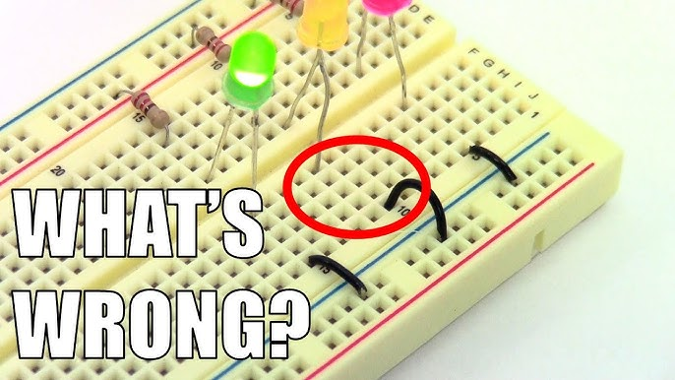
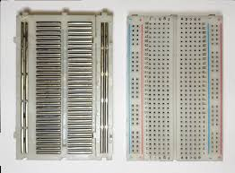
Wiring Errors…
Reminder: Breadboard rails!

Slide 8
Carry on with previous projects!

